Slide 1
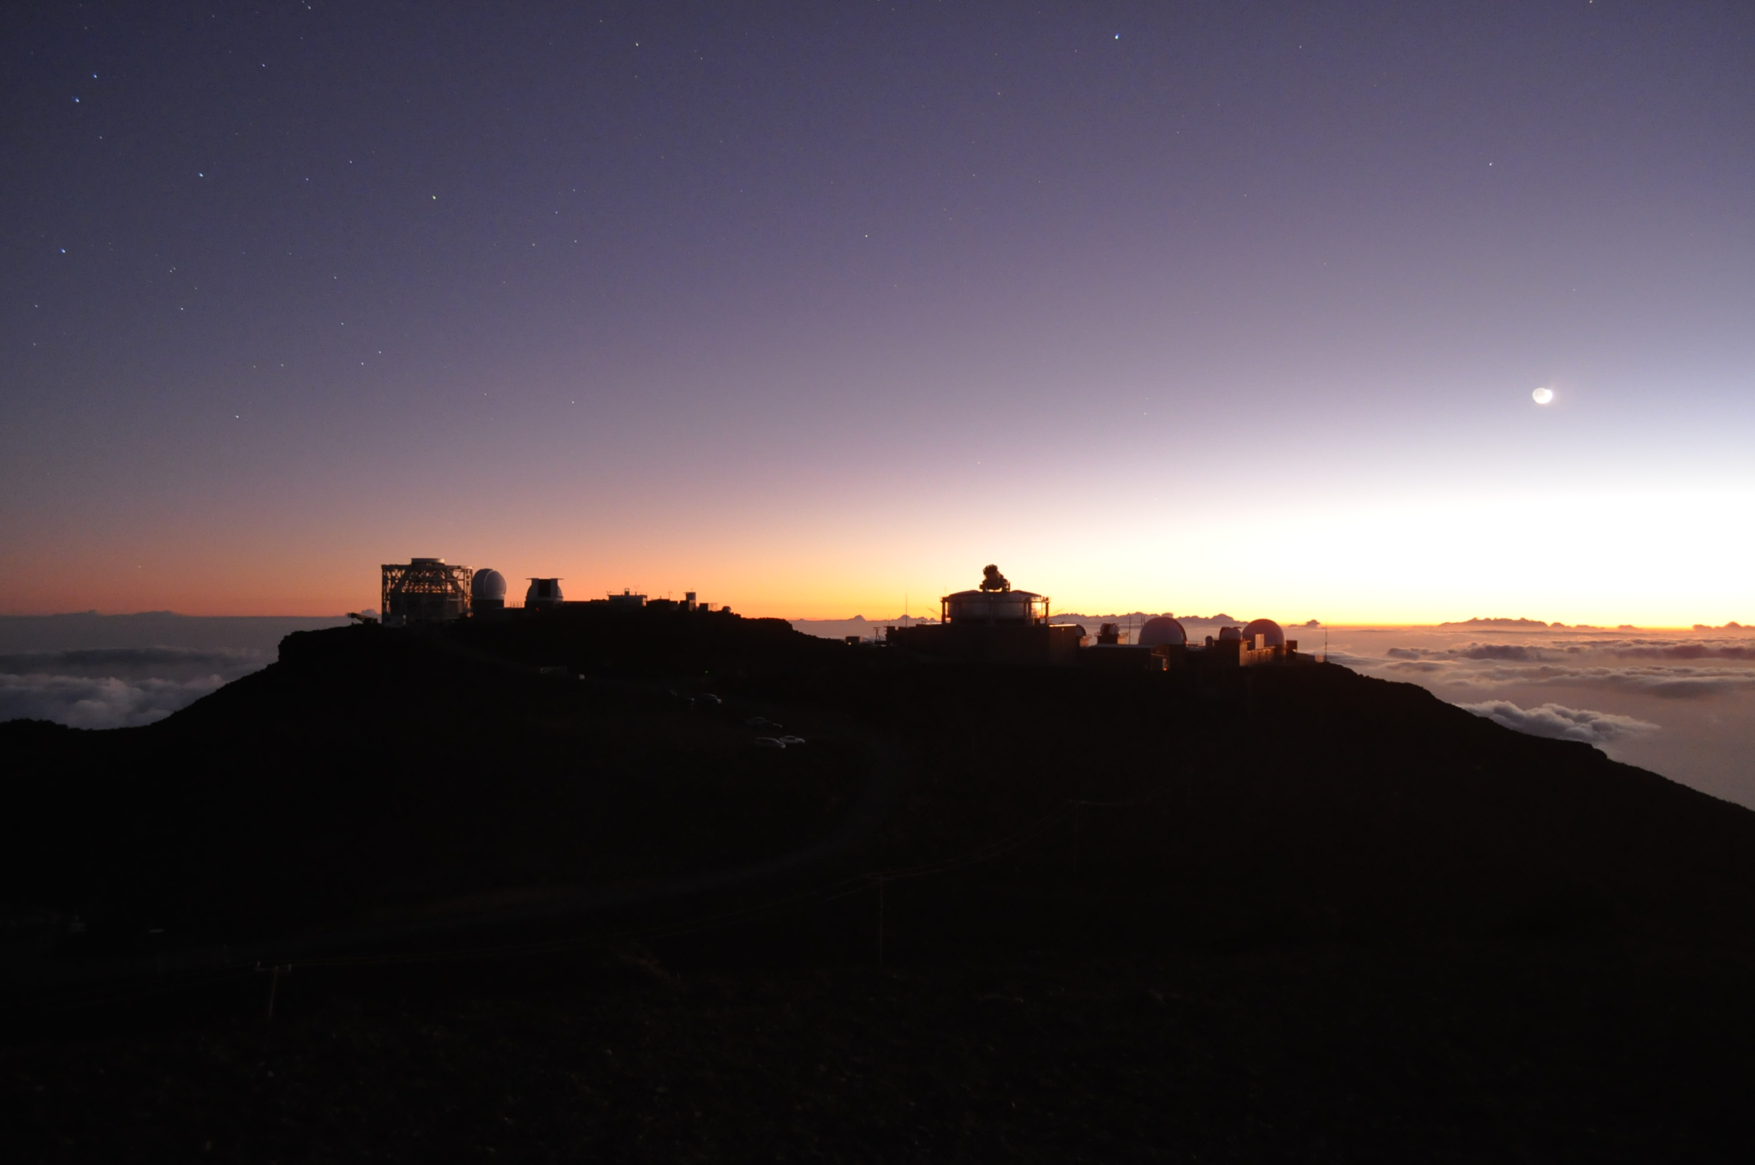
First light of 東北大 Haleakala 60cm 望遠鏡 (T60) in Sep. 2014:
超高波長分解能レーザヘテロダイン分光器の
惑星への挑戦
中川広務¹, 青木翔平^{1,2}, 笠羽康正¹, 村田功¹
Guido Sonnabend⁴, 佐川英夫³, 岡野章一^{1,5}, 鍵谷将人¹
*坂野井健¹, Jeff Kuhn⁵, Joe Ritter⁵, 伊藤一成¹
（¹東北大, ²IAPS/INAF (Italy), ³京都産業大,
⁴Radiometer Physics GmbH (Germany), ⁵Univ. Hawaii）
2014年12月4日第４回可視赤外線観測装置技術ワークショップ（三鷹）

Slide 2
なぜ惑星大気観測のために赤外高分散分光が
必要なのか？
- ダイナミクス、化学反応のトレーサーとなり得る微量気体や同位体比（火星メタン、H2O/HDO等）の測定
- 惑星高層希薄大気中のnon-LTE発光の測定
- 詳細スペクトルから気体数密度（高度プロファイルも）や、ドップラーシフトから風速を測定
- 地球大気と惑星大気の吸収線または発光線の分離

Slide 3
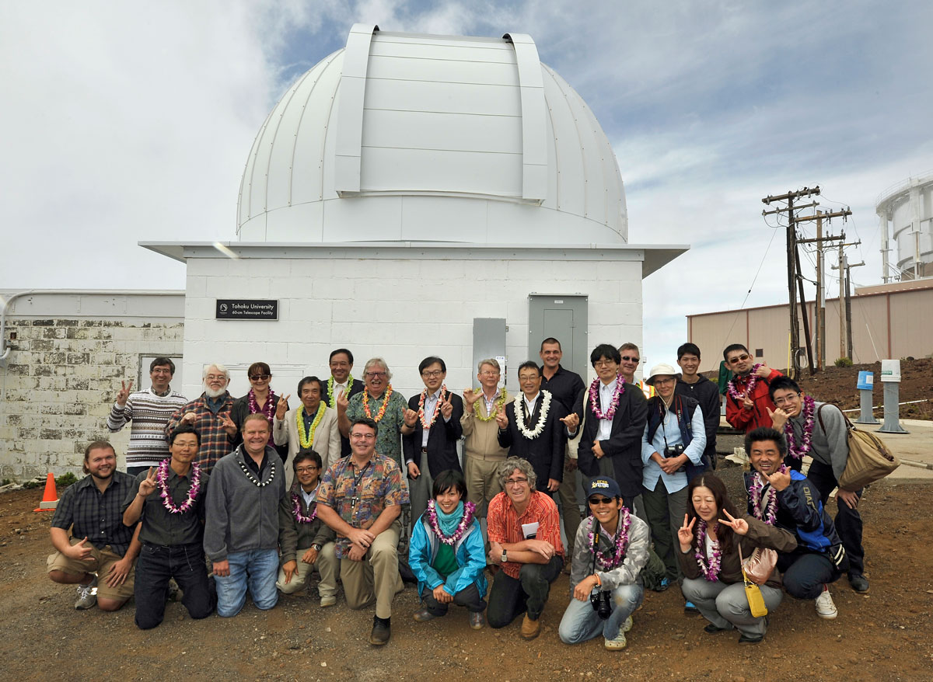
T60 Open Ceremony - 8 Sep. 2014

Slide 4
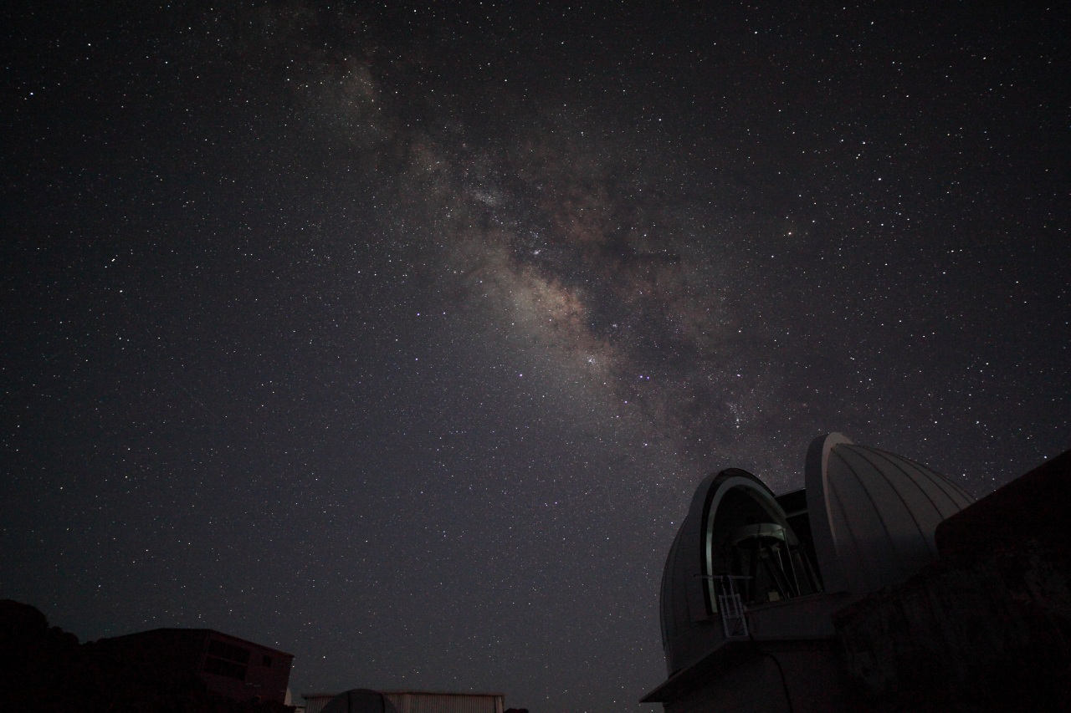
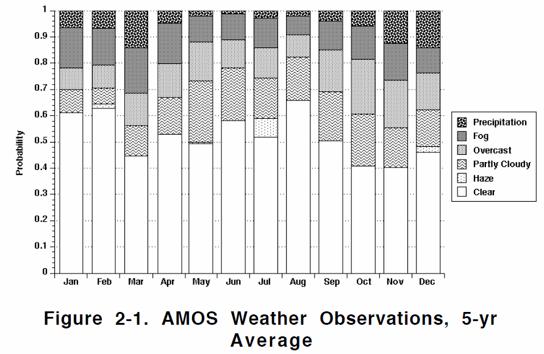
Night View of Tohoku Univ. 60cm (T60)
晴天率0.6～0.7

Slide 5
Purpose of Tohoku Univ. 60cm (T60)
Flexible - Conjugated operations with
large telescopes & space missions
Continuous monitoring - Temporal variabilities in diurnal, seasonal solar cycle
Unique instrument – including ‘Infrared’ and visible
high-resolution spectroscopy
[First instrument]
Mid-Infrared LAser Heterodyne Instrument (MILAHI) λ/dλ ~ 10⁶⁻⁷
Visible filter imager
[Future plan]
Visible Echelle spectrometer λ/dλ ~ 50000
Near-Infrared (1-5um) Echelle spectrometer (ESPRIT) λ/dλ ~ 20000

Slide 6
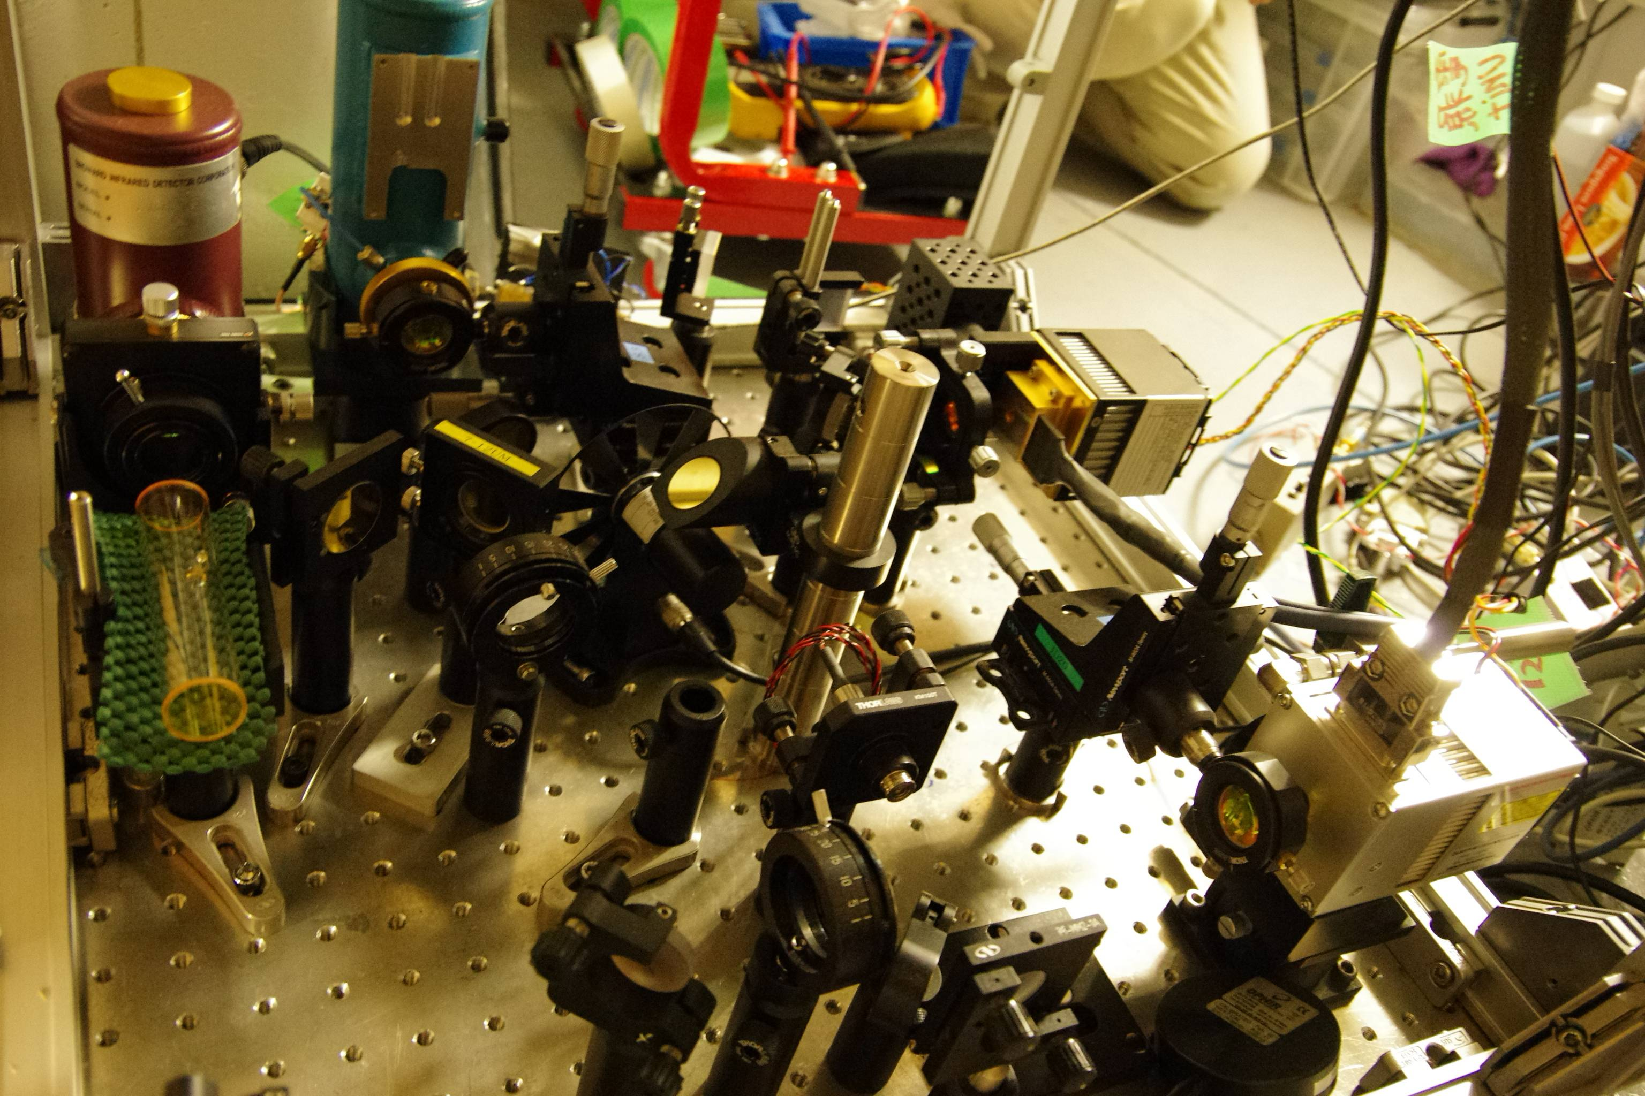
IR Heterodyne instrument on T60 (Sep. 2014) [Credit: Ohkusa]

Slide 7
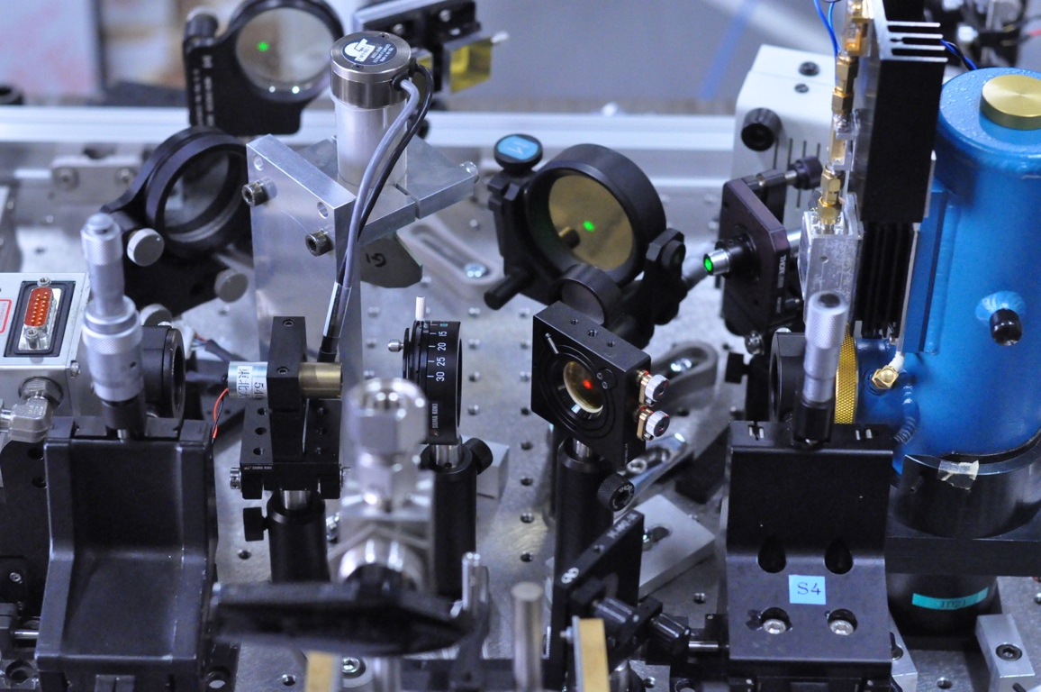
IR heterodyne: Principle
TELESCOPE
CALIBRATOR
FLIP MIRROR
ZNSE
BEAM SPLITTER
QC LASER
PHOTOMIXER
MCT detector
Bandwidth 2GH
R_{TOA} = ε_{B}(T_{surf}) e^{-τ} + R_{UW}
IR flux from the planet through its atmosphere ...
I_{het} = R_{TOA} R_{LO}
… is combined with IR from local (laser) and
focused on Photomixer.
I_{het} = I_{DC} + I_{IF} = P_{S} + P_{L} + 2√ P_{S}P_{L}cos(2π γ_{IF} t - φ)
Output is in Radio region (Bandwidth: ~2 GHz) of
the electromagnetic spectrum.

Slide 8
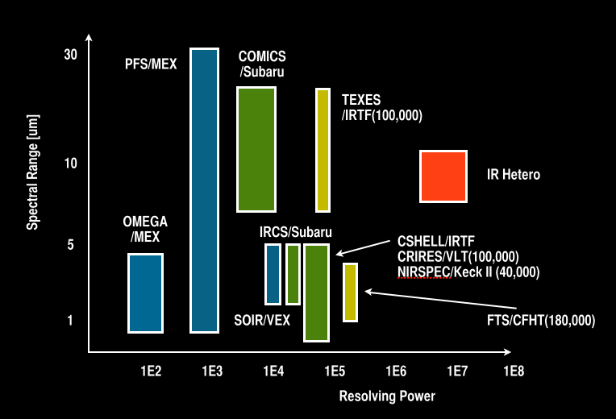
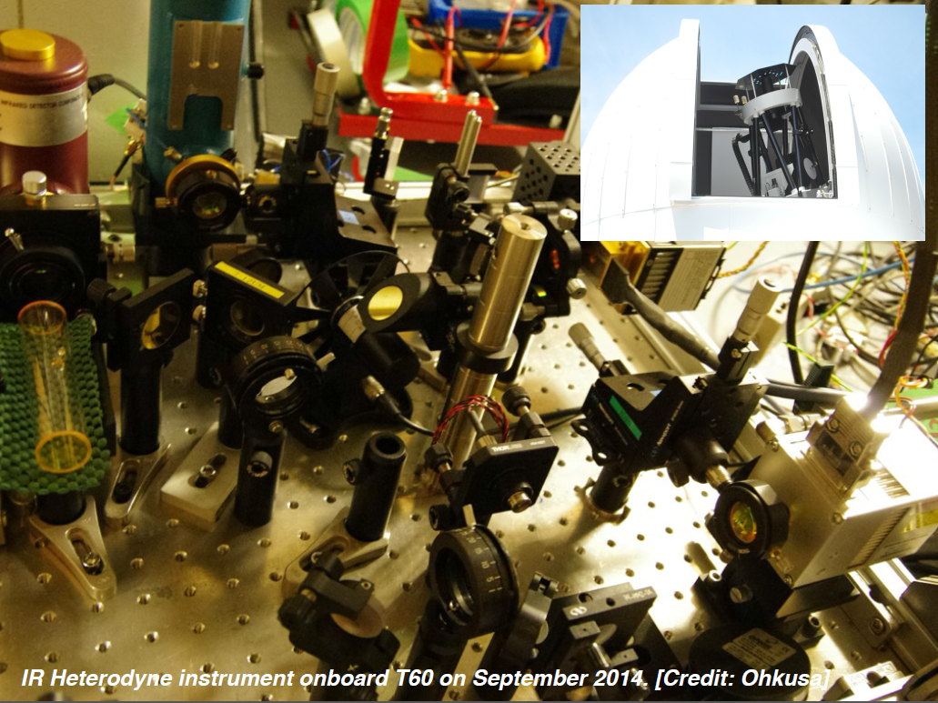
Advantage of IR heterodyne
Sensitive detection of minor trace gases
Wind and temperature (10 m/s & 10K accuracy)
Mapping with vertical profiles (3D structure)
Many organic molecules
Small-sized
(good for space-,
balloon- applications)

Slide 9
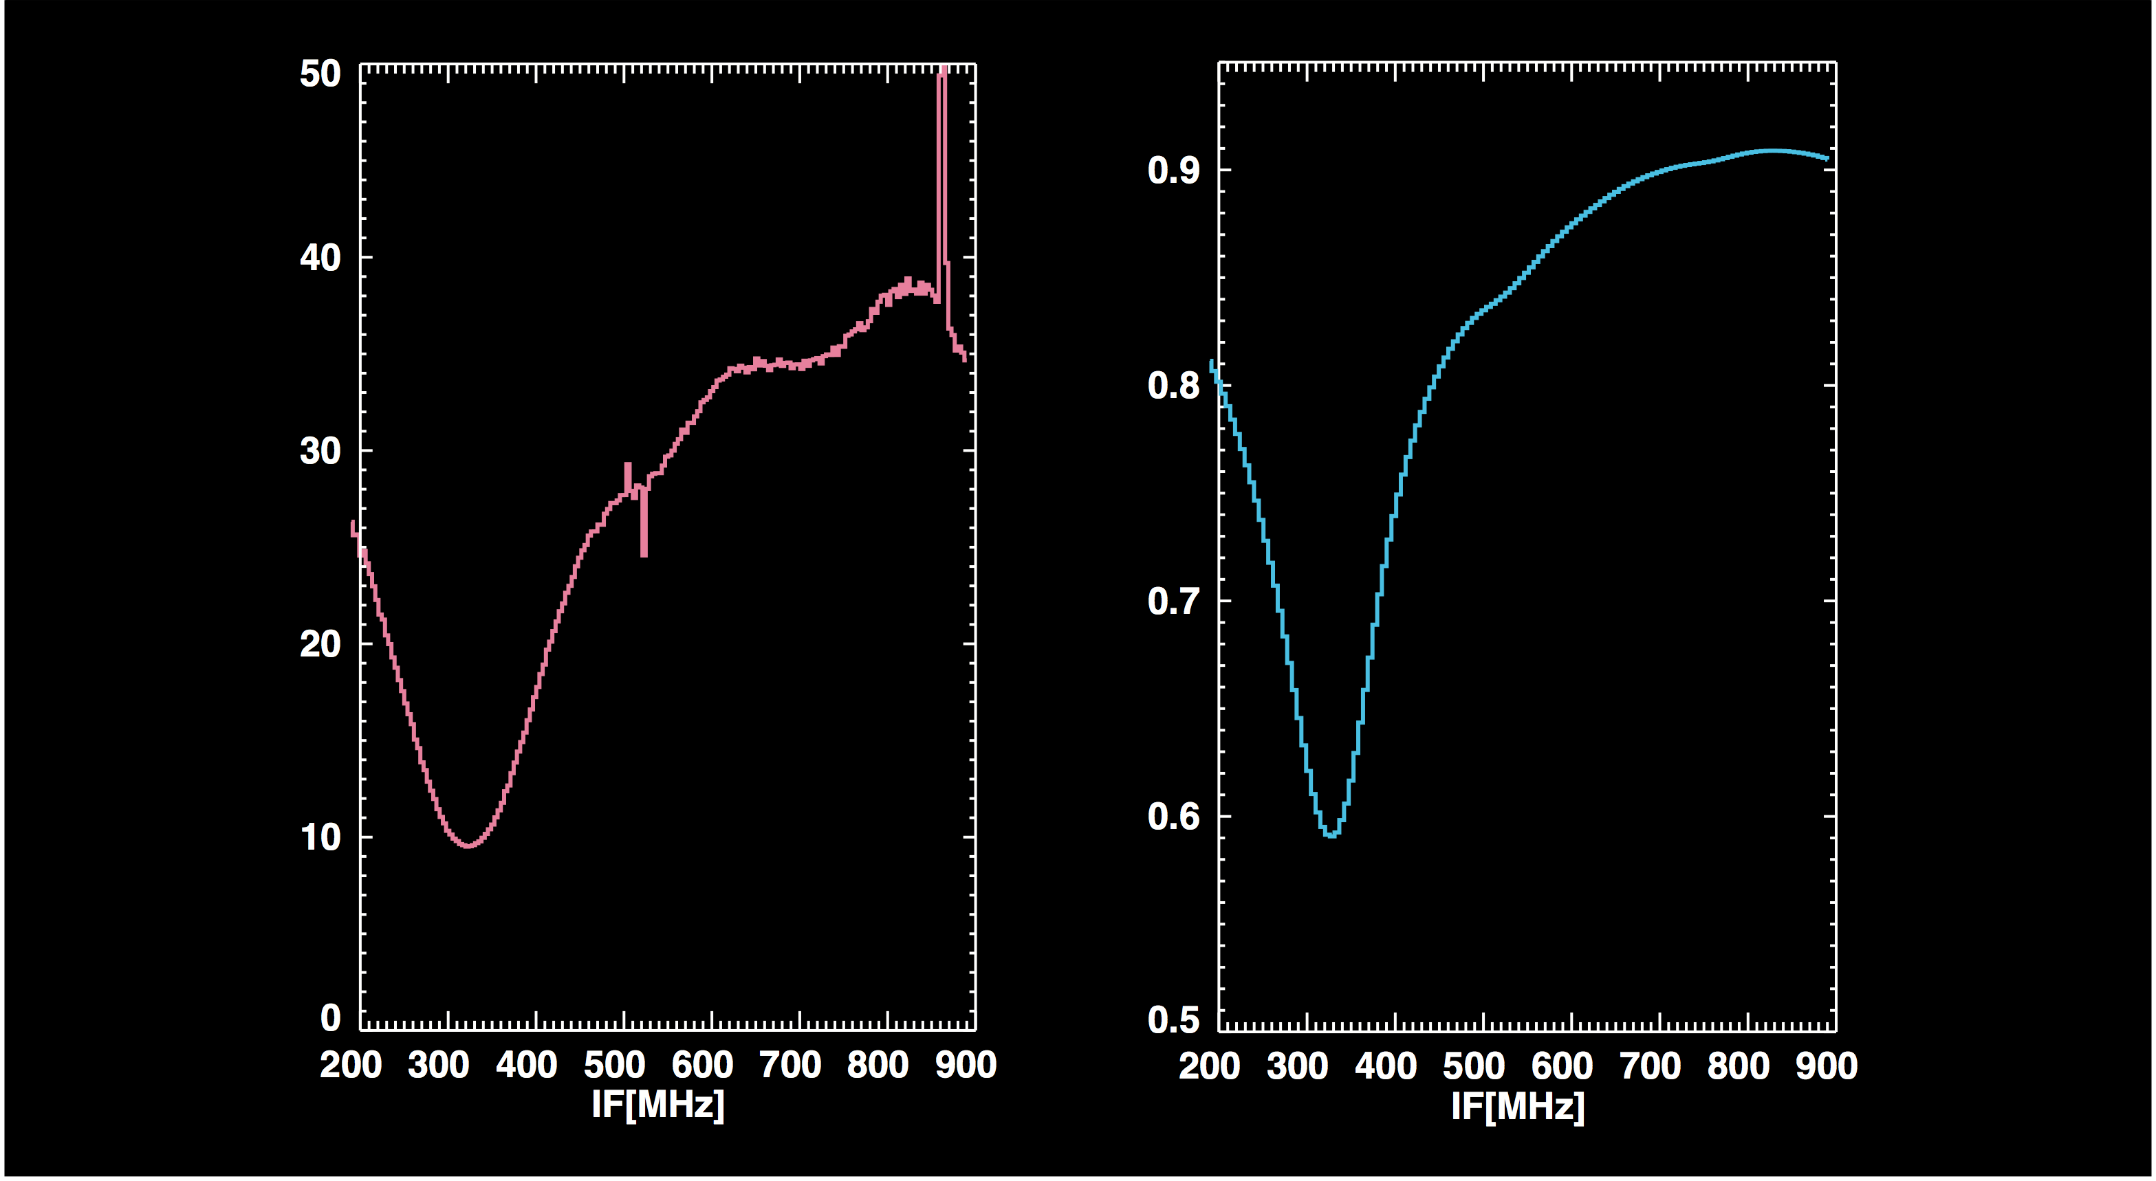
Data at Laboratory with Sun light (ATRC, Univ. Hawaii)
IR heterodyne
Calculation
O3(668)
O3(667)
O3(668)
O3
Observed terrestrial O₃ at Laboratory in coelostat sunlight at 1043.864 cm⁻¹
(1GHz bandwidth, 1MHz res., 10min integration time on Mar. 2014)

Slide 10
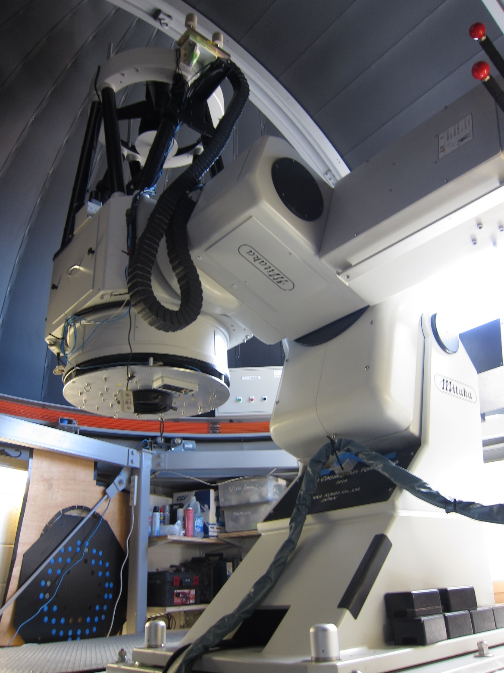
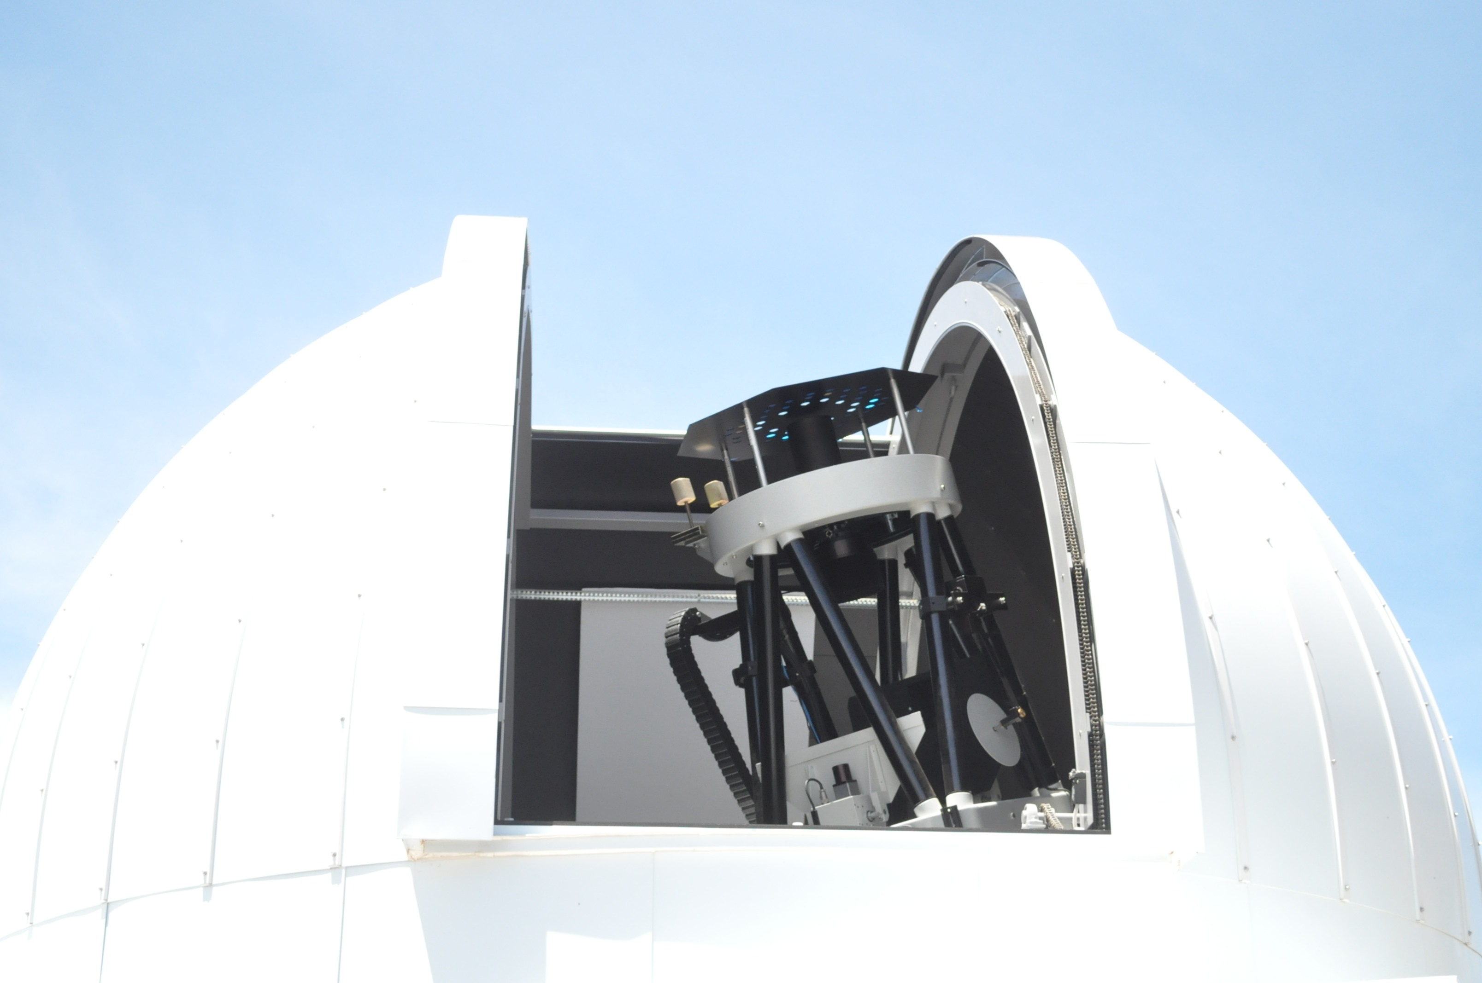
Sun (terrestrial atmosphere) at T60 !
Reduced sunlight is led into the instrument.

Slide 11
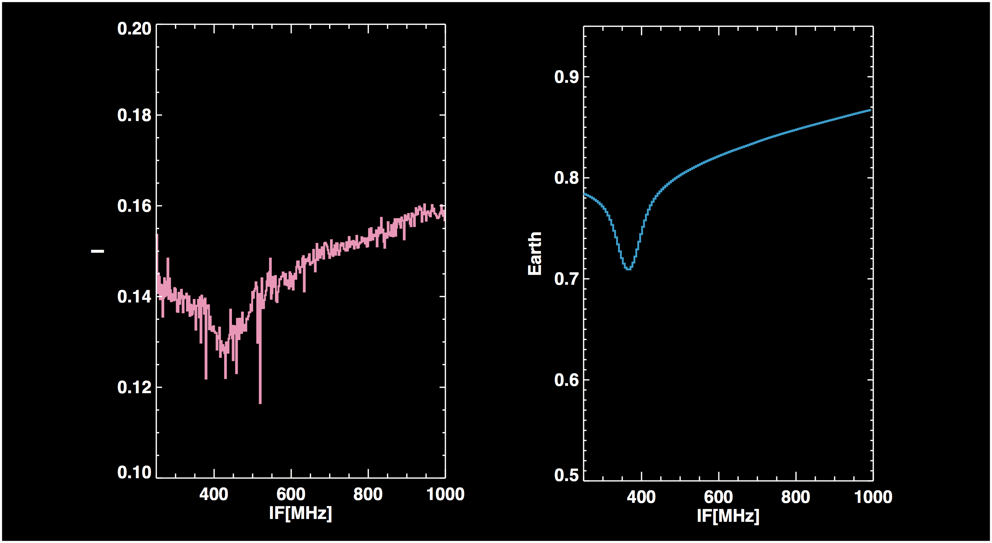
Sun (terrestrial atmosphere) at T60 !
IR heterodyne
Calculation
0.02cm-1
Observed terrestrial CO₂ spectrum with T60 at 970.532 cm-1
(1GHz bandwidth, 2MHz res., 5min integration time on 3 Sep. 2014)

Slide 12
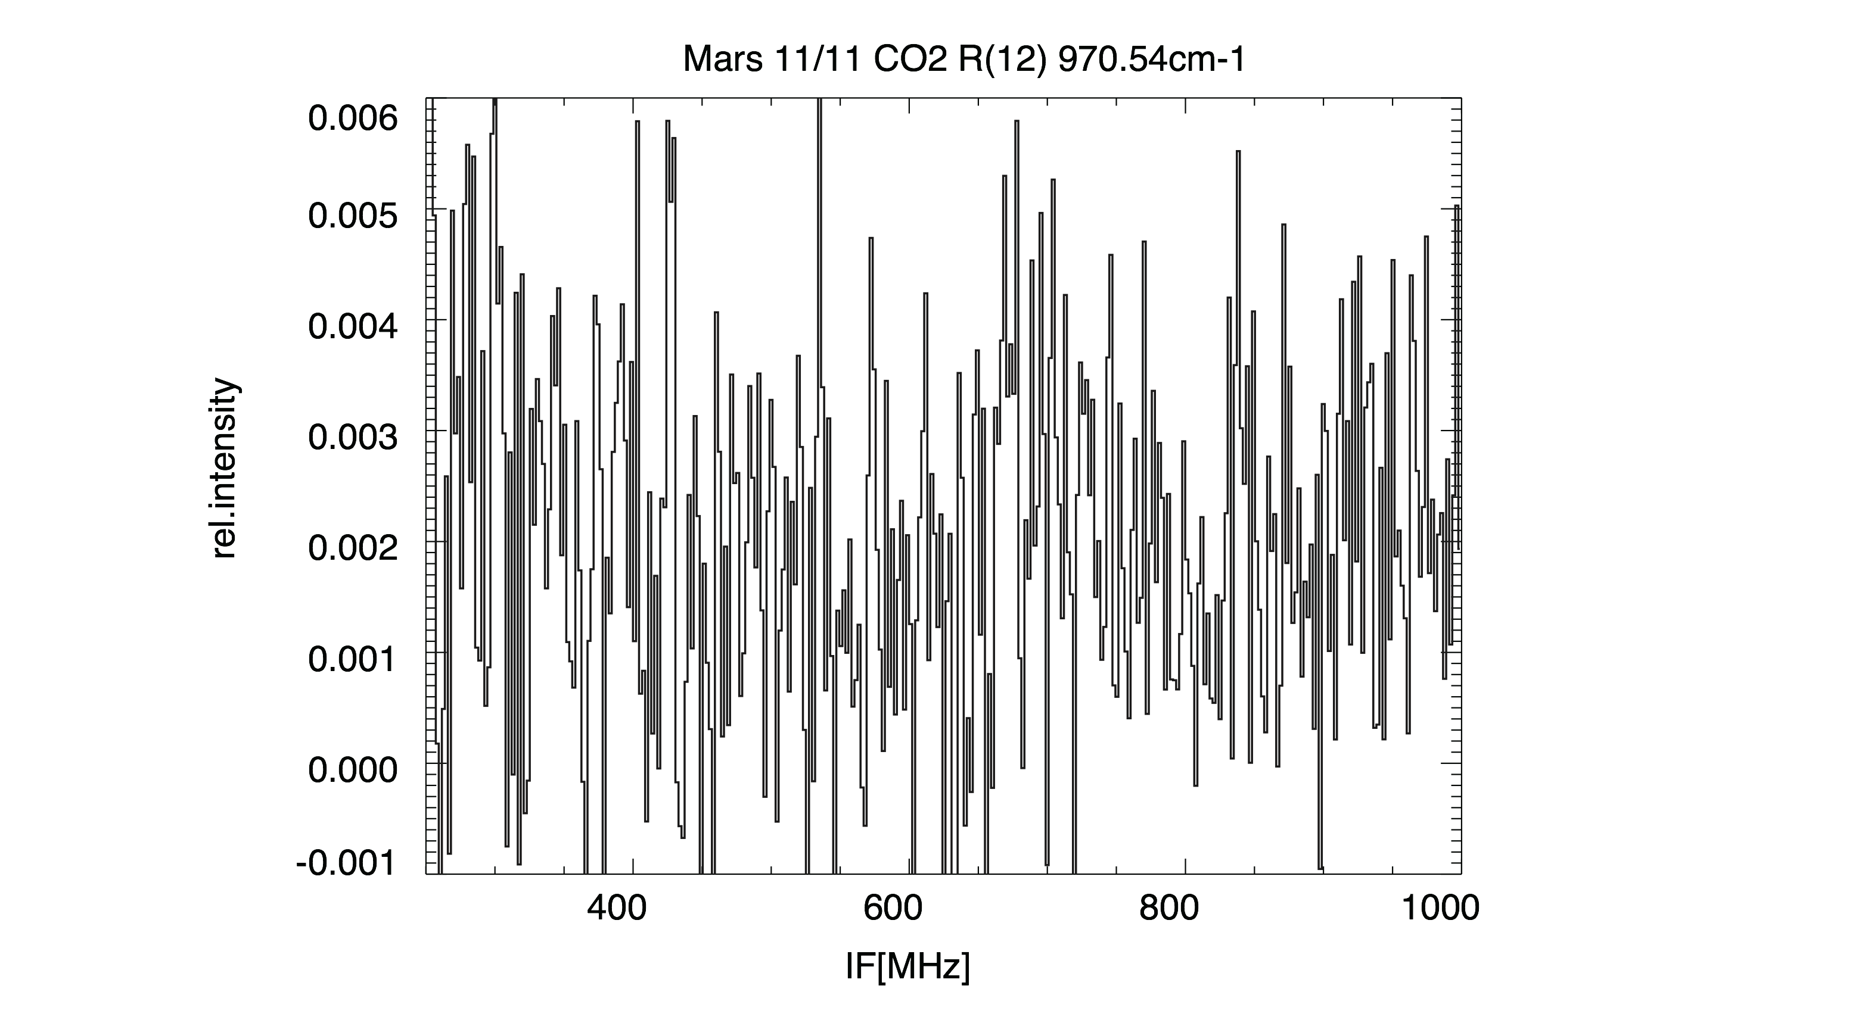
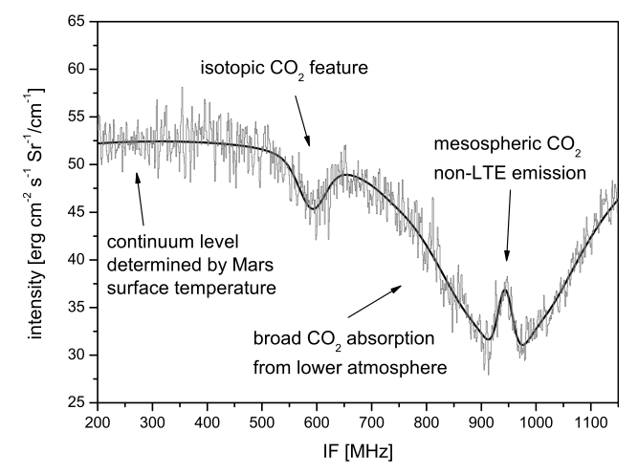
First detection of Mars non-LTE emission with T60 !
(ref) Previous study
[Sonnabend et al., 2006].
Fig. Mars CO2 non-LTE emission spectrum obtained by IR heterodyne instrument onboard T60 on 11 November 2014. Integration time is 10min. FOV is located at the center of Martian disk.
Observed Martian CO2 spectrum by T60 at 970.532 cm⁻¹ (2MHz res.)
on 14 Nov. 2014

Slide 13
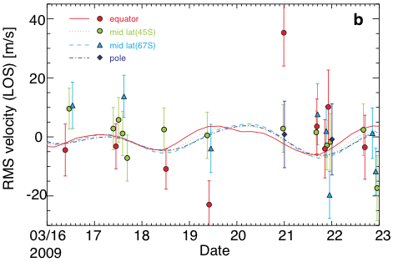
Heterodyne Target: with λ/dλ>1,500,000
Isotope map, HDO/H2O
(Villanueva+, 2008)
IRTF/HIPWAC
(Fast+, 2009)
Detection of CH4
(Sonnabend+, 2009)
Mesospheric Wind and T
Seasonal var. of oxidisor, H2O2
(Lefevre+, 2009)
(Nakagawa+, 2013)

Slide 14
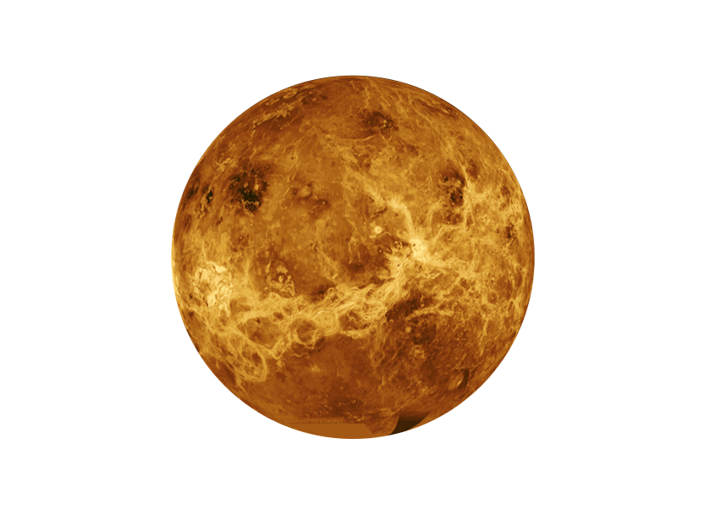
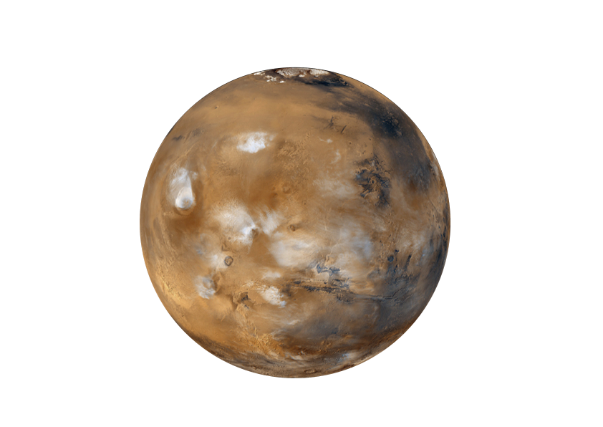
Spatial Resolution of MILAHI with T60
64”
15”
2.6”@7um
3.5”@10um
Beam
size
Mars
Venus
Fig. Comparison between the instrumental FOV of Tohoku 60cm-telescope and targets. Resolved disk image can be obtained to investigate global distributions of physical parameters.

Slide 15
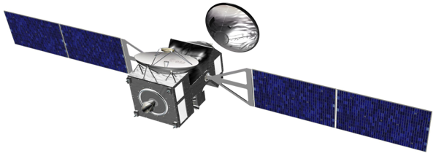
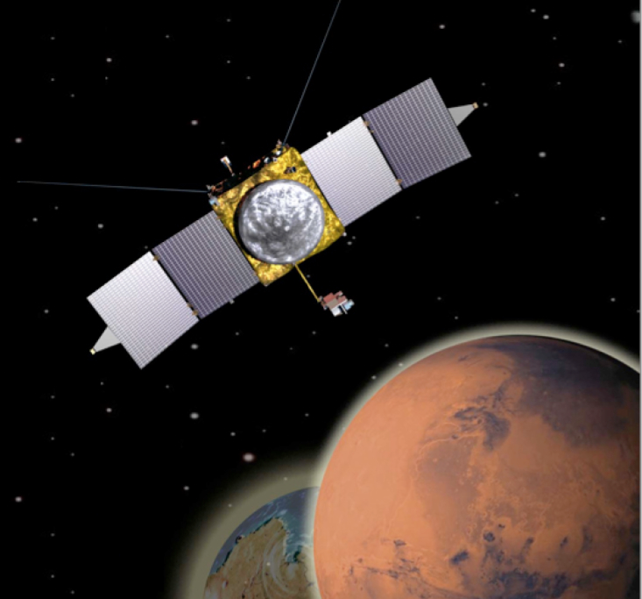

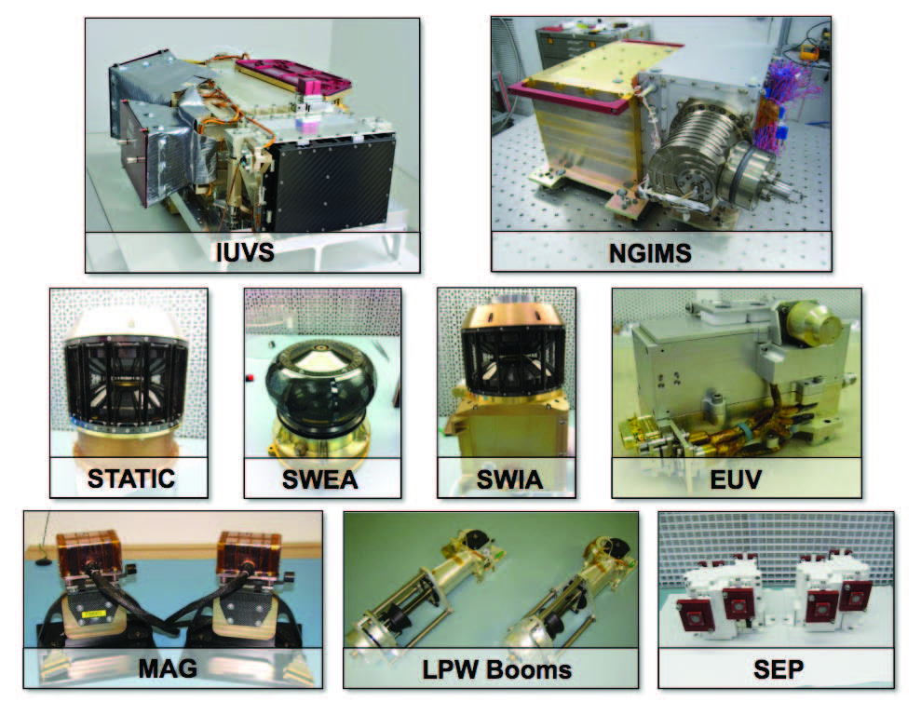

MAVEN
Trace Gas Orbiter
2015-
2016 Launch
NASA
ESA + Roscosmos
NOMAD
High resolution occultation
and nadir spectrometers
Atmospheric composition
(CH₄ ,O₃ , trace species, isotopes)
dust, clouds, P&T profiles
UVIS (0.20 – 0.65 μm) λ/Δλ ~ 250
SO
Limb
Nadir
IR (2.3 – 3.8 μm) λ/Δλ ~ 10,000
IR (2.3 – 4.3 μm) λ/Δλ ~ 20,000
SO
CaSSIS
High-resolution camera
Mapping of sources;
landing site selection
ACS
Suite of 3 high-resolution
spectrometers
Atmospheric chemistry, aerosols, surface T,
structure
Near IR (0.7 – 1.7 μm) λ/Δλ ~ 20,000
SO
Limb
Nadir
IR (Fourier, 2 – 25 μm) λ/Δλ ~ 4000 (SO)/500 (N)
SO
Nadir
Mid IR (2.2 – 4.5 μm) λ/Δλ ~ 50,000
SO
FREND
Collimated neutron detector
Mapping of
subsurface water

Slide 16
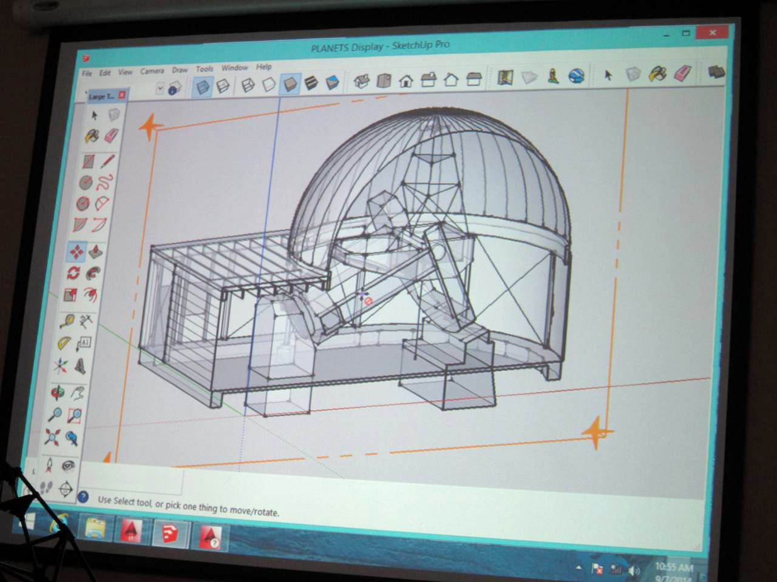
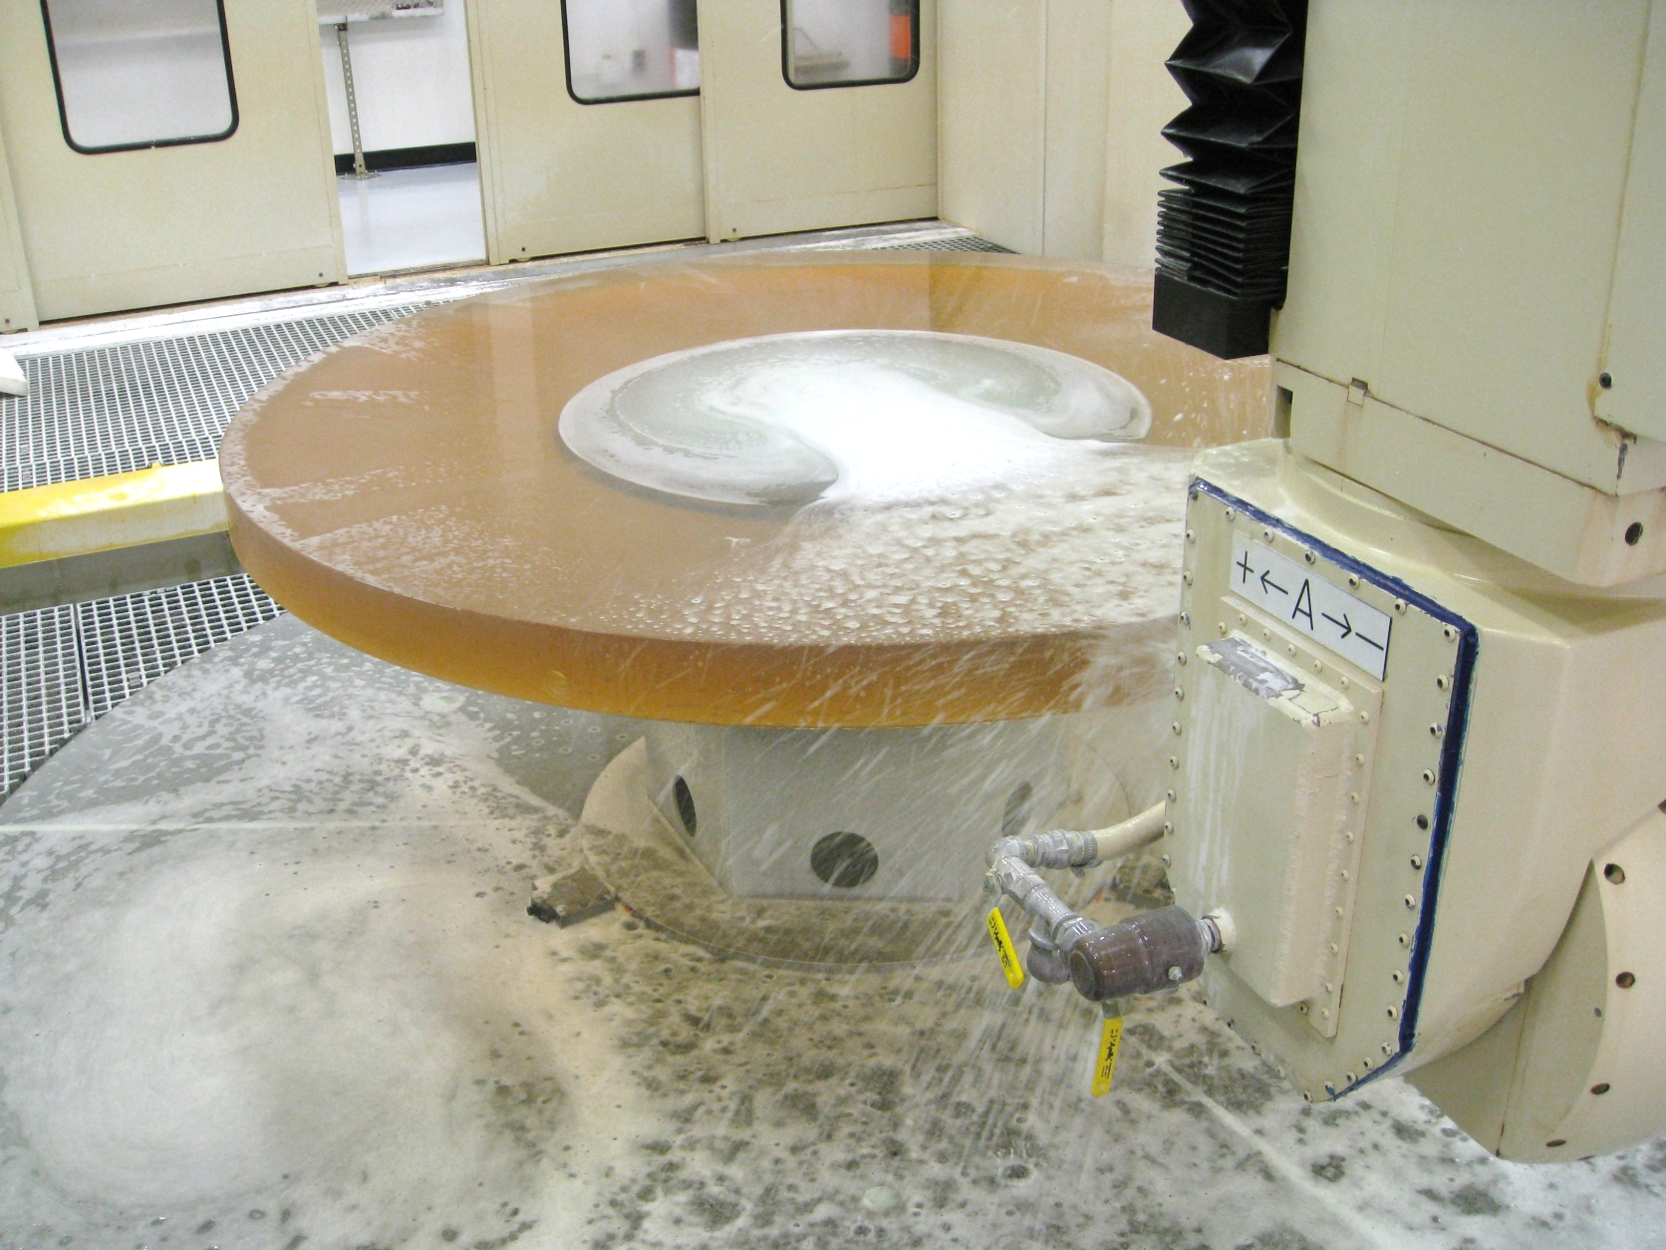
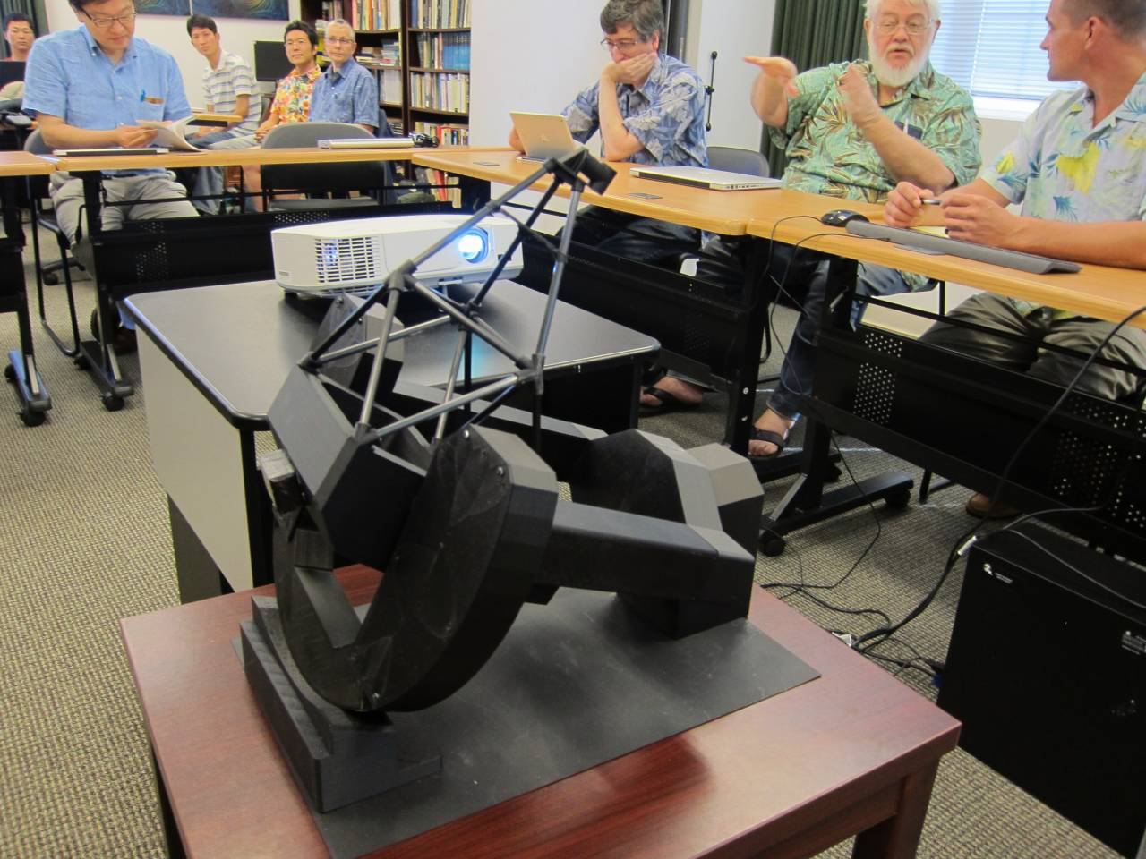
Haleakala 2m telescope ‘PLANETS’ meeting
(Sep. 7, 2014)
First light: end of 2016
[fastest case]
Gregorian focus
F/12.8 (f=23040mm)
Coude
(F/50)

Slide 17
Summary
MILAHI, a new infrared heterodyne instrument with λ/dλ ~ 10⁶⁻⁷ finally started its initial run attached to Haleakala T60.
Feasibility on T60 was demonstrated by solar observations
(terrestrial and solar atmospheres).
We are going to Martian observations
in Nov 2014 and March-September 2015
for the monitor of lower atmosphere just below MAVEN observations.

